Slide 1

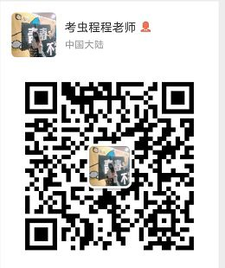

托福听力1
金牌听力名师
大菁儿老师
2021.5.31

Slide 2


美国顶级商学院，北美求学工作
乐学英语创始人
独家听力教学体系
从多个维度帮助上万学员在托福考试中取得高分
曾担任多家大型知名教育集团教学总监
用学生最得心应手的方法，让零基础学员在最短时间内提分
根本上颠覆学习听力的思维方式
诙谐，幽默的教学方式受到无数学员的追捧
vx: 520103442 微博：酵母菁
没有不进步的学员，只有教不好的老师！

Slide 3
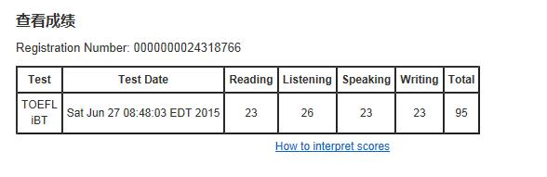
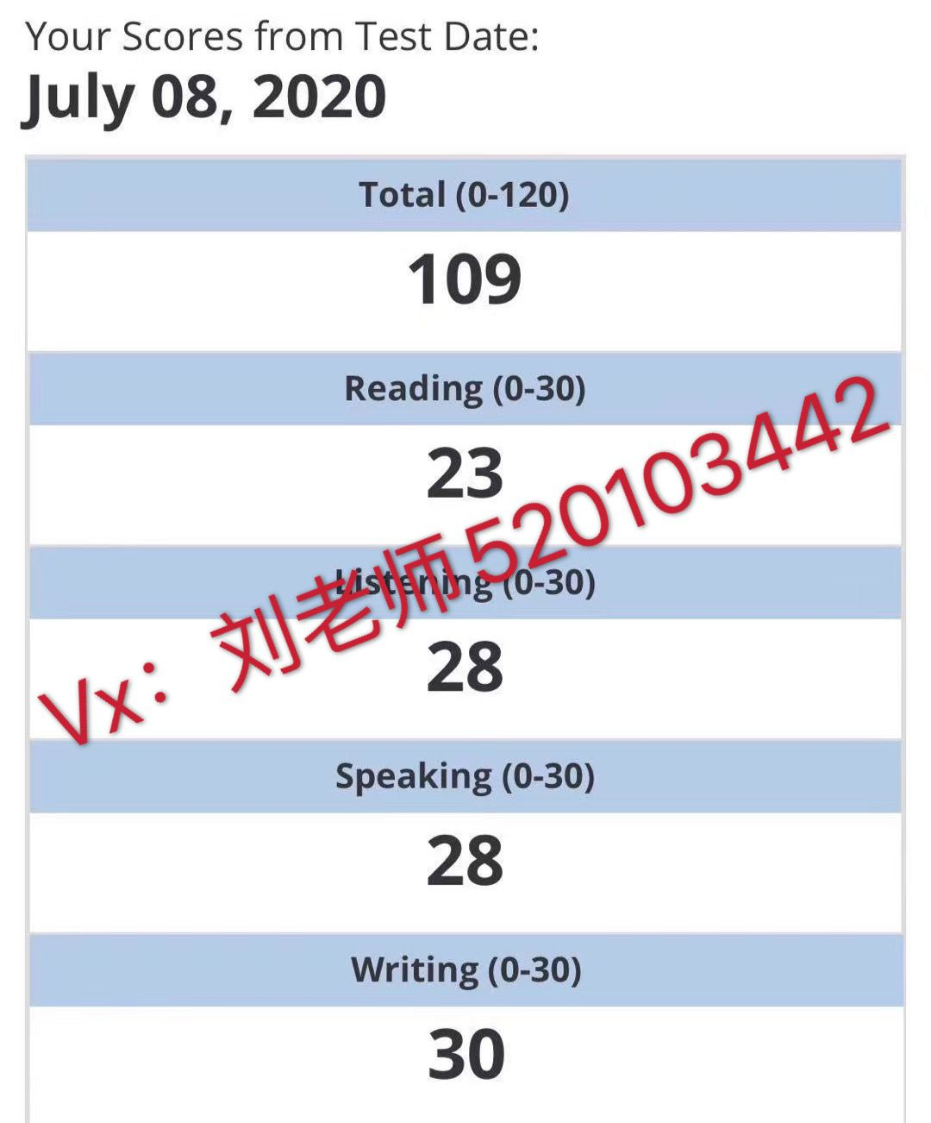
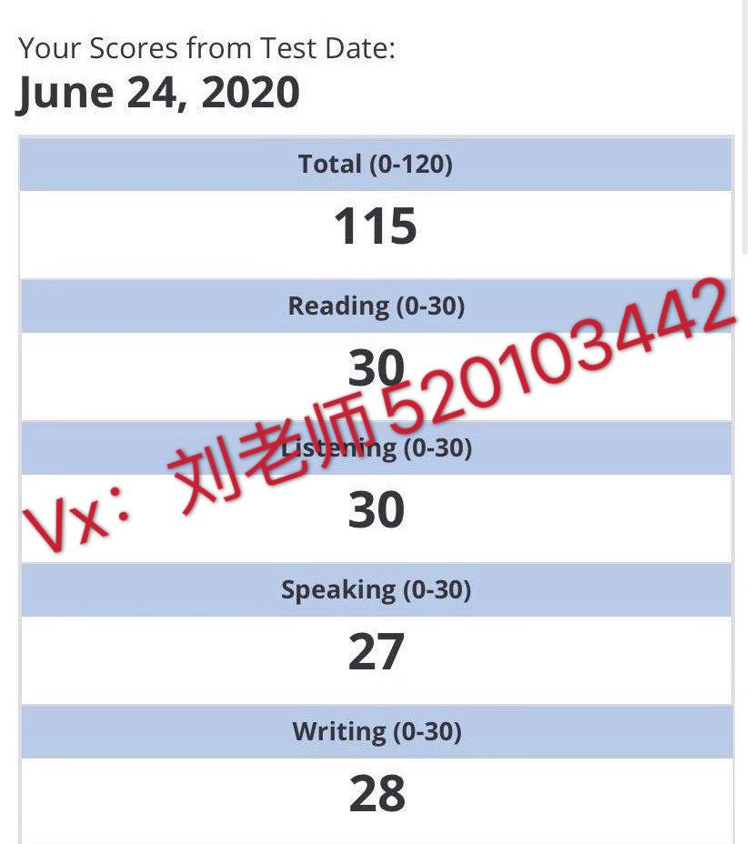
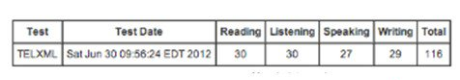
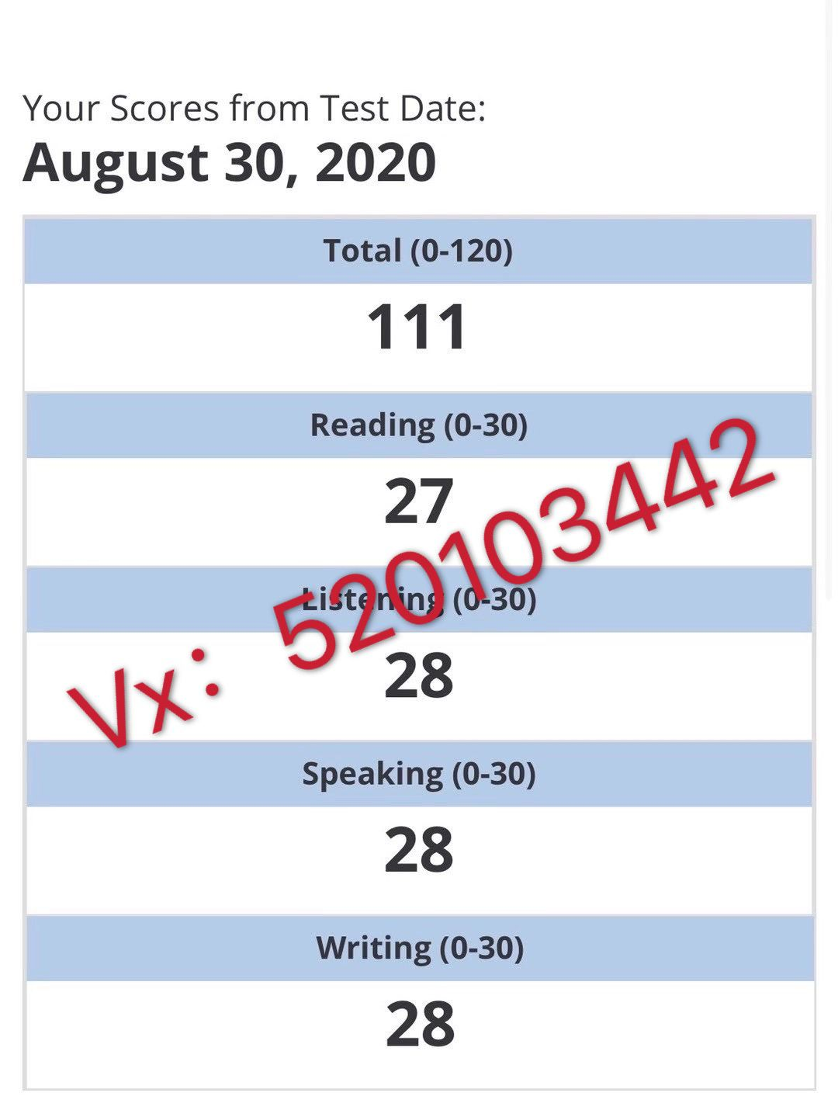
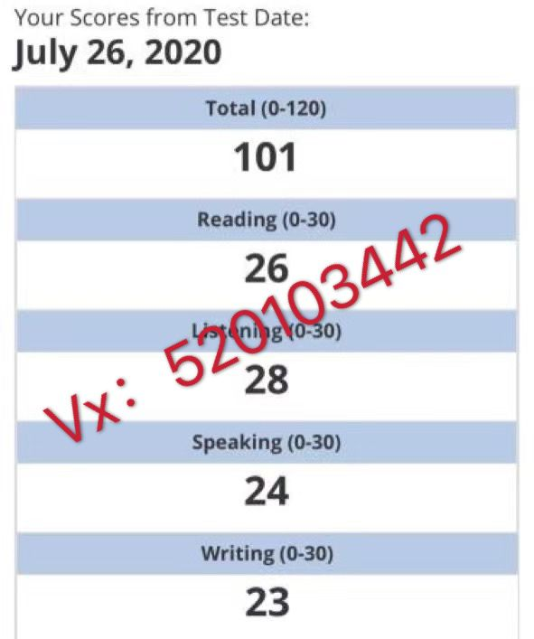

Slide 4
介绍改革后的托福听力特征及考试规则；
托福听力的常见问题；
从听力角度背单词；
托福听力总原则；
长对话的分类；
长对话部分的题型——主旨题解题技巧
长对话部分的题型——细节题解题技巧

Slide 5
test section | before 2019.8.1 | after 2019.8.1
listening | 4-6 lectures 6 questions each 2-3 conversations 5 questions each 60-90 min | 3-4 lectures 6 questions each 2-3 conversations 5 questions each 41-57 min

Slide 6
改革前有加试
section 1:
对话1 +讲座1+讲座2
Section 2:
对话2+讲座3+讲座4
Section 3:
对话3+讲座5+讲座6
改革后有加试
section 1:
对话1 +讲座1+讲座2
答题时间：17题共10mins
Section 2:
对话2+讲座3
答题时间：11题共6’30 mins
Section 3:
对话3+讲座4
答题时间：11题共6’30 mins
（各section的出场顺序不固定）

Slide 7
变化： 1. 口音变多、语速变快 2. 多选题变多 3. 主旨需要总结

Slide 8
改革后听力的备考策略： 1. 真题+TPO：1.25倍/1.5倍速 2. 学会看听力文本及错题分析

Slide 9
托福听力常见问题？

Slide 10
托福听力常见问题
单词听不懂

Slide 11
托福听力常见问题
录音长，走神

Slide 12
托福听力常见问题
单词懂，但是句子不知道什么意思

Slide 13
托福听力常见问题
听了后面忘前面

Slide 14
托福听力常见问题
专注记笔记 遗漏后面内容-----听、记都不熟练
先听文章，再做题目，不知道记什么-----不知考点规律
听到什么记什么-----不会提取重要信息
考的没听见，也没记上
记了也看不懂记的什么-----不成体系的笔记方法

Slide 15
托福听力常见问题
连读、吞音、弱读、语气词
不明白作者的意图

Slide 16
解决方案
听：精听——对症下药
记：精析——捕捉文章逻辑重点

Slide 17
背单词的方法
1. 边读边写 3-5遍 A4纸
2. 看中文写英文 3-5遍 A4纸
3. 听音频想中文 练习t
1-3个月

Slide 18
听力设立目标
小目标：听懂70%，不浪费
20%- 70% ：1-3个月 每天精听>1小时
70%-100%：>半年 方法得正确
大目标：不浪费的同时有效推断达到效果最大化
听：精听——对症下药
记：精析——捕捉文章逻辑重点
关键：知道文章什么地方重要

Slide 19
托福听力总原则
顺序原则：笔记和题目要一一对应
先选项后笔记：更易找到答案 排除选项
关键词对应是第一原则
正确选项：和主题相关！注意读每个词，防陷阱
否定词仔细听：实词虚词（eg: I can swim）/反复跟读
分段：一个信息不考两次、意群---意思

Slide 20
长对话的分类
长对话之人物与场景
学生与教授* （学业学术类话题） | 学习成绩，论文布置，迟交论文，学术问题，选择专业，学习规划，学术活动，通知，交换意见，上课表现
学生与工作人员*（校园服务类话题） | 图书馆借书与还书，费用缴纳，校园服务，购买物品或服务，查询信息，寻求资助，找工作，阐述解决问题，租房
学生与学生* （商量学校相关事宜） | 谈论校园热点新闻，讨论学业协商组织校园活动，

Slide 21
长对话题型及解题技巧
1. 主旨题问法区分：
Why does the student go to see his professor?
What are the speakers mainly discussing?
原则：答案在对话发起人那里
练习TPO49-C1图书馆场景

Slide 22
TPO49-C1 主旨题：
What are the speakers mainly discussing?
A. The student's difficulties locating sources for a research project
B. The topic of the student's research project
C. The student's request to visit a particular part of the library
D. Procedures for requesting different editions of a book

Slide 23
TPO49-C1图书馆场景 ：Listen to a conversation between a student and a librarian.
MALE STUDENT: Uh, hi, I need to get into Special Collections. In particular the British Literature. I was working with some of the William Blake books.
FEMALE LIBRARIAN: Well, then you must know that access is restricted. 正确答案：C

Slide 24
练习TPO47-C1课程询问场景
主旨题：Why does the student go to the woman's office?
A. To schedule an audition to join an orchestra
B. To ask a question about a music class he is taking
C. To get information for an article he is writing
D. To ask a question about a lecture the woman gave

Slide 25
TPO47-C1课程询问场景：
NARRATOR: Listen to a conversation between a student and a music director.
MALE STUDENT: Ms. Harper?
FEMALE DIRECTOR: Yes, can I help you?
MALE STUDENT: Hi, my name's Eric Patterson. I'm a journalism student. Uh, I wanted to ask you about the orchestra…
FEMALE DIRECTOR: I'm sorry Eric, but the orchestra is only open to music majors.
MALE STUDENT: Really? Well, see—
FEMALE DIRECTOR: But the policy's changing next year. After that, if you've taken three music courses, you will be able to audition.
MALE STUDENT: Well, uh, I have taken some music courses, and I do play the double bass, so maybe that’s something to think about. But actually, I was hereabout something else.
FEMALE DIRECTOR: Oh, sorry! It's just I-I get that question all the time, so…
MALE STUDENT: That's OK. Thing is, I work for Magna—the school paper—and I'm reporting on last week’s concert.Now, I went to it, and I really enjoyed it, but now I’m looking for some background knowledge. 正确答案：C

Slide 26
2. 细节题：
出现并列及问答，正确答案在回答里
通常是考什么问题或针对问题的解决建议
问法：
When will the woman go to the lab?
Why does the critic dislike the ancient style of sculpture?

Slide 27
TPO28-C1师生讨论——论文修改建议：
细节题：
3.What revisions does the student need to make to his paper?
[Click on 3 answers.]
A. Describe the influences on Dewey in more detail
B. Expand the introductory biographical sketch
C. Remove unnecessary content throughout the paper
D. Use consistent references throughout the paper
E. Add an explanation of Dewey's view on individuality

Slide 28
But you haven’t presented the information in a systematic way. I really think this portion on individuality needs to come later, after your paragraphs on Dewey’s intellectual influences（A) I do think there are areas that can be cut. I guess what I am saying is that your paragraphs aren’t really presented in a logical order. The direction of your argument isn’t crystal clear. And there’s some unnecessary material getting in the way. (C) But remember, everything needs to be consistent when it comes to referencing. It is a very important academic convention (D)
正确答案：ACD

Slide 29
TPO17-C1师生讨论——为论文寻找视频资源
细节题：3.What do the speakers say about Peter Brook's production of A Midsummer Nights Dream? [Click on 2 answers.]
A. It influenced subsequent productions.
B. It was performed only a few times.
C. Written accounts of it are difficult to find.
D. Film versions of it probably do not exist.

Slide 30
Professor:I mean at all. That particular production was never filmed or recorded. Student：Oh no. I had no idea. From what I read, that production, like, it influenced every other production of the play that came after it. So I just assumed it had been filmed or videotaped.
Professor：Oh,It definitely was a landmark production. And it’s not like it ran for just a week, but either it was never filmed or if it was the film’s been lost. And it’s ironic because there’s even a film about the making of the production, but none of the production itself.
正确答案：AD

Slide 31

课后作业：
1.体会上课讲的原则点 制定精听计划
2.上课涉及的conversation回家听完整版，完成对应题目
3.完成TPO45-50所有主旨题和细节题
菁爷赠言：
最重要的是方法，其次才是努力和勤奋！

Slide 32
练习：
TPO14-C1 找政治书
political science class
on reserve
quit
weird

Slide 33
TPO14-C1找政治书
1.Why does the student go to see the man?
A. To find out the status of her job application.
B. To get help locating a book she needs for a class.
C. To request a book that her professor put on the reserve list.
D. To ask how to look up books on the library's computer system.

Slide 34
TPO14-C1找政治书
2.Why is the student having a problem getting the book she wants?
A. Other students are using the book in the library.
B. The book is kept in the political science library.
C. The student has the incorrect title for the book.
D. All the copies of the book have been checked out of the library.

Slide 35
TPO14-C1找政治书
3.Why does the man think a student job in the library is available?Click on 2 answers.
A. An employee recently stopped working at the library.
B. One position has been open since the beginning of the semester.
C. The library only recently got approval to hire additional staff.
D. Not many students are looking for work this time of year.

Slide 36
TPO14-C1找政治书
4.What is a potential problem with the available job in the library?
A. The position is only a temporary one.
B. The position is for fewer hours per week than other student jobs.
C. There may not be flexibility to select convenient working hours.
D. The librarian may prefer to hire a student with previous library work experience.

Slide 37
TPO14-C1找政治书
5.Listen again to part of the conversation.Then answer the question.Why does the man say this:
A. To acknowledge that there is a problem with the reserve system
B. To indicate how the library avoids the problem the student mentioned
C. To explain why the library has ordered more copies of the book
D. To reinforce the reason why so many books are not on the shelves

Slide 38
练习：
TPO10-C2 return literature book
merchandise
gear full gear
withdraw
literature
make an exception
syllabus

Slide 39
TPO14-C1 return literature book
1 Why does the student go to the bookstore?
A. To purchase a book by Jane bowles.
B. To find out which books he need for a course.
C. To return a book that was originally assigned for a course.
D. To find out how to order a book for a course.

Slide 40
TPO14-C1 return literature book
2 What is the store's policy about giving refunds on books?Click on 2 answers.
A. Books that are not for a specific course will receive a store credit instead of a refund.
B. Course textbooks can be returned for a full refund early in the school semester.
C. All books must be returned within two weeks to be eligible for a full refund.
D. Only books that are in new condition will get a full refund.

Slide 41
TPO14-C1 return literature book
3 Why is the professor not going to discuss the book by Jane bowles in the class?
A. There is not enough time left in the semester.
B. Not all of the students were able to get a copy of the book.
C. The professor miscalculated the difficulty level of the book.
D. The book was not on the course syllabus.

Slide 42
TPO14-C1 return literature book
4 What does the woman imply about the book written by Jane Bowles?
A. It is worth reading.
B. It focuses on a serious topic.
C. She is not familiar with it .
D. She read it for a literature class.

Slide 43
TPO14-C1 return literature book
5 Why does the man mean when he says this?
A. He thinks the store's policy is too strict.
B. He is happy that the woman has agreed to his request.
C. He is surprised at the woman's suggestion.
D. He is annoyed that he needs to give the woman more information.

Slide 44
End

